Slide 1
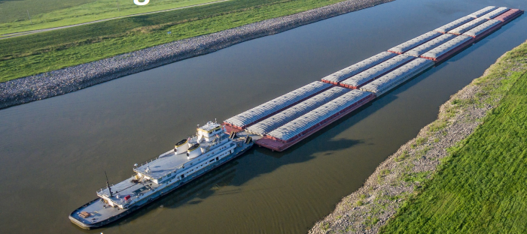
OPTIMIZATION OF INLAND WATERWAYS TOW PLANS

Slide 2
Understanding The Problem Statement
An Inland Waterways port has to schedule the loading operation of barges to tows.
Barges are stationed in a fleet and connected to each other and the spar barges.
At an instance of time, there are B barges waiting to be loaded into T Tows.
To do the loading operation, V number of vessels are used.
Develop an optimal tow plan to inform the allocation of barges to the tows, allocation of vessels to barges and the sequence of loading the barges.
Notes:
Questions:
Will the fleets be stopping in all the ports along its transportation to unload the barges? Will there be any cases where a fleet carrying barges to a particular port alone?
Can a fleet have barges carrying different commodity types?
How the barges arrive to the port? In the current problem, we have assumed there are barges available to be loaded when we start this assignment

Slide 3
Questions to be Answered?
What is the priority of the Barges?
What should be the sequence of loading the barges to the Tow?
To which Tows, the Barges had to be assigned?
Which Vessels will carry the Barges to the Tows?

Slide 4
Methodological Approach
Prioritising the available barges to load based on the position of barge in the fleet, cargo type, time in fleet and time to delivery of the barges
01
Assigning the barges to the vessels and tows with the objective of minimizing the operational costs and assigning tows to destination for minimizing number of stoppages
02
Assigning the Barges to Vessels to minimize the time of loading operation, and Visualizing the loading Operation.
03

Slide 5
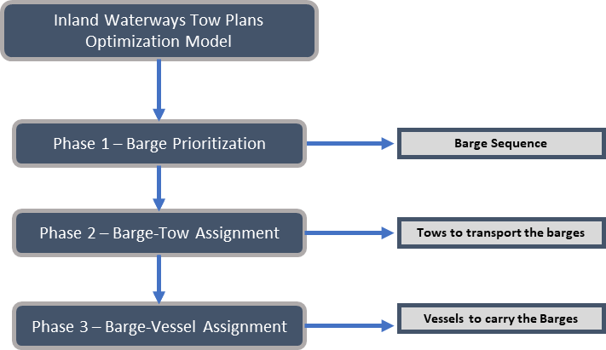
Methodological Approach

Slide 6
Phase 1 – Prioritizing and Sequencing the Barges
Priority Scores for Position of the barges in the fleet – Single shot barge buried metric; Type of Cargo – 0.5 for perishable good and 1 for non-perishable good; Time to delivery; Time in Fleet.
The values are normalized using min-max normalization
Equal weights are given to all the parameters (0.25)
Priority score is calculated as the product sum of weights and respective normalized values
The Barges are ranked in the ascending order of the priority scores, giving the sequence

Slide 7
Phase 2 – Barge-Tow Assignment
The problem is modelled as a multi objective optimization problem that assigns barges to the tows which minimizes the hours of operation, minimizes the number of stoppages at ports and groups barges with similar destinations into a tow, considering the priority element.
Indices and Sets
t, T – Index and Set of Tow Boats respectively, t ∈ T
b, B - Index and Set of Barges respectively, b ∈ B
v, V – Index and Set of Vessels respectively, v ∈ V
p, P – Index and Set of Ports respectively, p ∈ P
Parameters:
Dbt – Distance between Barge b and Tow t
Desbp – Destination Matrix of Barge b to Port p
Cv – Cost of Operating Vessel v
Cf – Fixed Cost of Stopping
Cp – Variable Cost of Stopping at a Port per Barge
Capt – Capacity of Tow t
Sup_{v} – Upstream Speed of Vessel v
Sdown_{v} – Downstream Speed of Vessel v
Priority_{bt} – Priority score for barge b to be assigned to tow t

Slide 8

Phase 2 – Barge-Tow Assignment
Decision Variables:
X_{bvt} – 1 if Barge b is assigned to Vessel v and Tow t, 0 otherwise
Y_{tp} – 1 if Tow t stops at Port p, 0 otherwise
Z_{tp} – Number of Barges b delivered to Port p by Tow t
Objective_1
$$Minimize(\sum_{t∈T}{\sum_{v∈V}{\sum_{b∈B}{X_{bvt }∗ C_{v}}}}∗\left[\left(\frac{D_{bt}}{{Sup}_{V}}\right)+ \left(\frac{D_{bt}}{{Sdown}_{V}}\right)\right] + \sum_{t∈T}{\sum_{p∈P}{Y_{tp }∗\text{C}\text{f}+\sum_{t∈T}{\sum_{p∈P}{Z_{tp }∗ C_{p} )}})}}$$
Objective_2
$$Minimize(\sum_{t∈T}{\sum_{v∈V}{\sum_{b∈B}{X_{bvt }∗ {Priority}_{bt}}}}$$

Slide 9

Phase 2 – Barge-Tow Assignment
Objective Function
W1*Objective_1 + W2*Objective_2
Subject to,
$$\sum_{t∈T}{\sum_{v∈V}{X_{bvt }=1 ∀b∈B }}$$
$$\sum_{v∈V}{\sum_{b∈B}{X_{bvt }≤{Cap}_{t} ∀t∈T }}$$
$$Z_{tp}= \sum_{b∈B}{\sum_{v∈B}{X_{bvt }∗ {Des}_{bp } ∀t∈T; p∈P }}$$
$$Z_{tp }≤M∗Y_{tp} ∀t∈T; p∈P$$

Slide 10
Phase 3 – Barge-Vessel Assignment
Greedy Algorithm
This algorithm is designed to make the best decision available at every stage rather than considering the overall optimization of the problem
The assignment of a barge to a vessel is determined by two factors – the availability of the vessel and the processing time of barges on each vessel. Based on the sequence from Phase 1, the barge is assigned to the available vessel with the minimum processing time for that barge

Slide 11
Phase 3 – Barge-Vessel Assignment
Greedy Algorithm
The procedure for this simple greedy heuristic algorithm is as follows:
Calculate the processing times of the barges by each vessel.
For the first barge in the sequence, check what vessels are available for processing the barge.
Of all the available vessels, check which vessels have the minimum processing times and assign the barge to that vessel. Make that vessel unavailable for the time equal to the processing time of the assigned barge.
If more than one vessel has the same minimum processing times, assign the barge to any of the vessels and make the vessel unavailable for the time equal to the processing time.
Repeat the process for other barges in the sequence
End the process when all the barges are assigned to the respective vessels

Slide 12
Phase 3 – Barge-Vessel Assignment
Relaxed Optimization Model
The Object of this phase is to reduce the Makespan of the loading operation. Since Makespan Scheduling problems are NP-Hard to solve, the model is relaxed with having makespan as one of the parameters which gives the available operational hours of each vessels. A multi-objective optimization model is developed to minimize the process time and penalties and combined using the weighted sum method.
The model is as follows:
Indices and Sets
b, B - Index and Set of Barges respectively, b ∈ B
o, O – Index and Set of Order Sequence respectively, t ∈ T
v, V – Index and Set of Vessels respectively, v ∈ V
Parameters:
PTbv – Process time of Barge b by Vessel v
ATv – Available time of Vessel v
Penbo– Penalty scores for sequencing Barge b in Order Sequence o
Decision Variables:
Xbvo - 1 if Barge b is assigned to Vessel v in Order Sequence o, 0 otherwise
OTv – Total Operational time of Vessel v

Slide 13

Phase 3 – Barge-Vessel Assignment
Objective_1
$$Minimize\left(\sum_{b∈B}{\sum_{v∈V}{\sum_{o∈O}{X_{bvo }∗ {PT}_{bv}}}}\right)$$
Objective_2
$$Minimize\left(\sum_{b∈B}{\sum_{v∈V}{\sum_{o∈O}{X_{bvo }∗ {Pen}_{bo}}}}\right)$$
Objective Function
W1*Objective_1 + W2*Objective_2
Subject to,
$$\sum_{v∈V}{\sum_{o∈O}{X_{bvo }=1 ∀b∈B }}$$
$$\sum_{b∈B}{\sum_{o∈O}{X_{bvo }={OT}_{v} ∀v∈V }}$$
$${OT}_{v}≤ {AT}_{v }∀v∈V$$

Slide 14
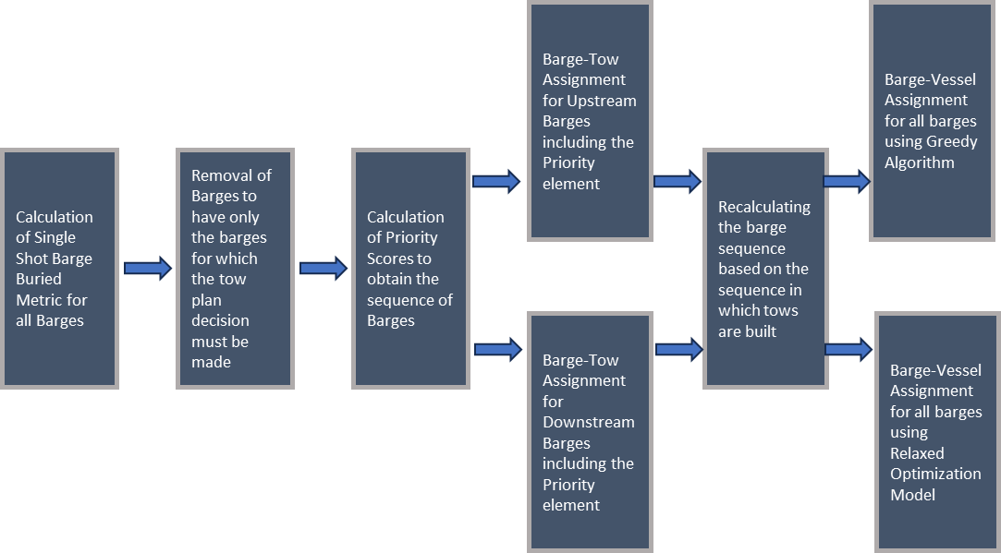
Overall Approach for solving LMR Scenario

Slide 15
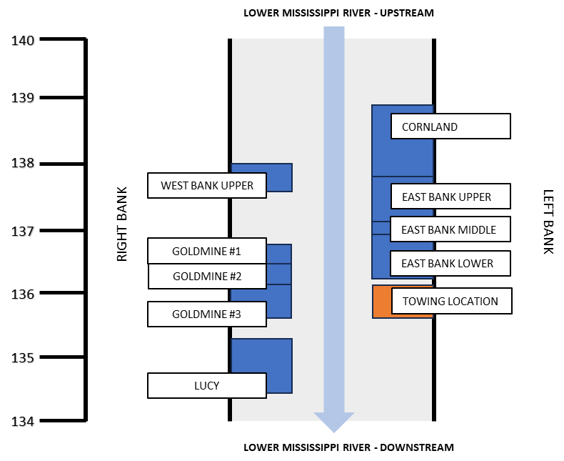
Representation of Fleets in LMR

Slide 16
Fleet Configuration and Barge Buried Metric
Cornland Fleet
Cornland Fleet - Single Shot Barge Buried Metric

Slide 17
Calculation of Priority Scores

Slide 18
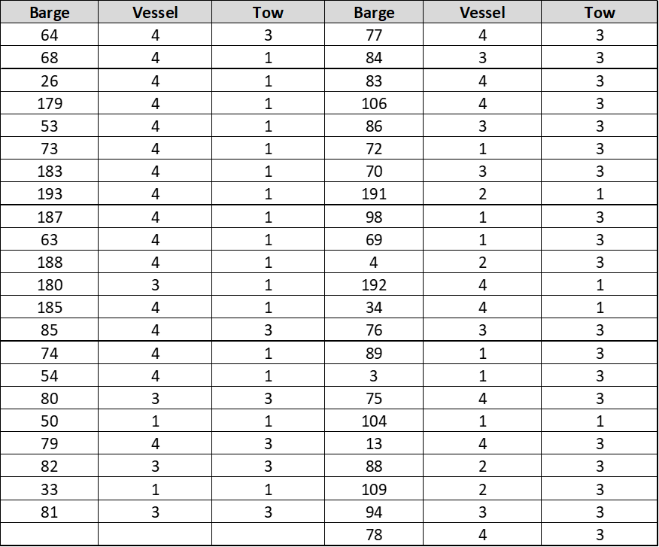
Barge-Tow Assignment for Upstream Barges

Slide 19
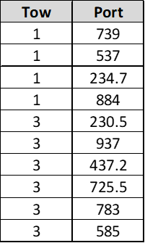
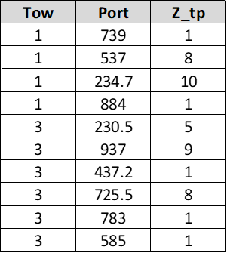
Tow-Port Combination for which the value of Y_{tp} is 1 for Upstream Barges
Value of Z_{tp} for Upstream Barges

Slide 20
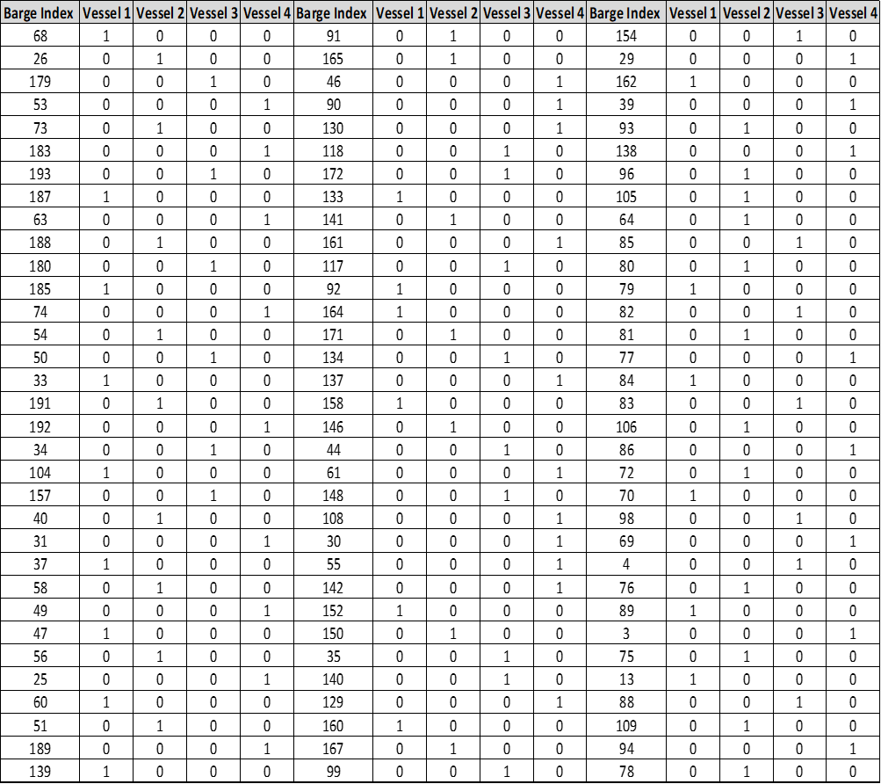
Barge-Vessel Assignment using Greedy Algorithm

Slide 21
Barge-Vessel Assignment using Relaxed Optimization Model

Slide 22
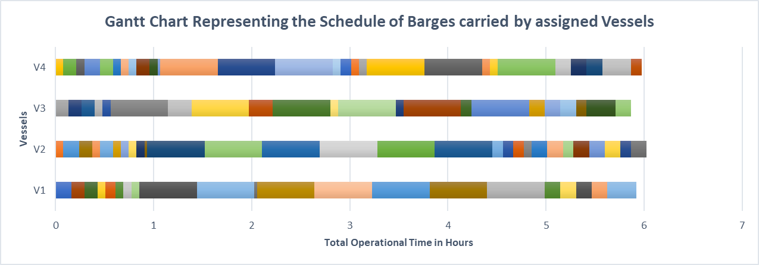
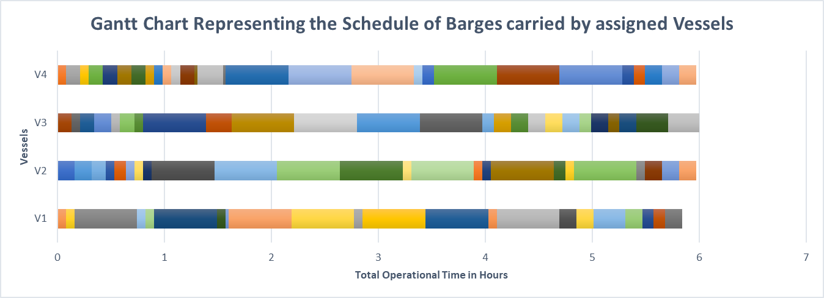
Gantt Charts for Vessel Workload using two approaches
Using Greedy Algorithm: Makespan = 6.03 hours
Using Relaxed Optimization Model: Makespan = 5.99 hours

Slide 23
Points to Discuss
Barges having nearer destination are delivered using smaller vessels itself. For these barges, the priority scores are calculated, and Barge-Vessel Assignment is made, skipping phase 2. In the results shown, these barges are completely excluded from the model.

